Slide 1
Deep Learning in Image analysis Lecture 3
Takashi Sato & Tom Jhou
Notes:
Ok, today and throughout the rest of this class, we will discuss deep learning . Probably most of you have heard the word deep learning or deep network, deep neural network, all mean the same thing. I’ve noticed that people tend to talk about it without having intuition on how it works and what it can do. So in the next few lectures we will aim to provide a good intuition on what this magical word means, and how we can employ it for our research.

Slide 2
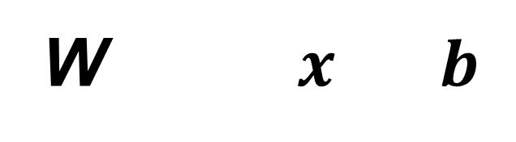
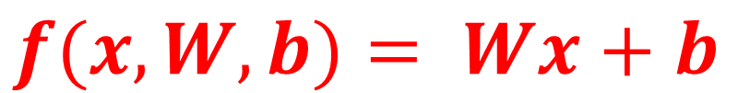
Linear classifier
$$f(x,W, b)= Wx+b$$
Weights
(10 x 3072)
Image
(3072,1)
Biases
(10,1)
Scores
(10 x 1)
25
w_{1,1}
w_{1,2}
...
w_{1,3071}
w_{1,3072}
29
b₁
25 x w_{1,1} + …. + 72 x w_{1,3072}
+b₁
cat
w_{2,1}
w_{2,2}
...
w_{2,3071}
w_{2,3072}
b₂
25 x w_{2,1} + …. + 72 x w_{2, 3072}
+b₂
W$x b$
=
dog
+
........
......
......
......
......
w_{10,1}
w_{10,2}
...
w_{10,3071}
w_{10,3072}
119
b₁₀
+b₁₀
25 x w_{10,1} + …. + 72 x w_{10,3072}
car
72
Input
Output
w_{1,1}
25
w_{1,2}
29
11.95
w_{1,3}
12.13
......
119
...
...
......
w_{1,3072}
72
2.56
(3072)
(10)

Slide 3
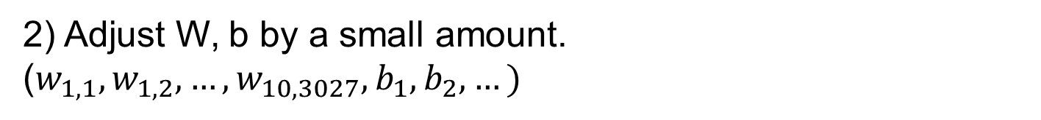
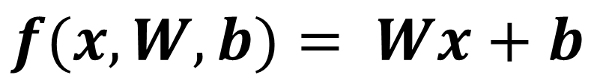
Linear classifier
$$f(x,W, b)= Wx+b$$
Using 50k training dataset, optimize W, b iteratively.
The training starts with a random values in W, b.
1) Evaluate the linear classifier.
2) Adjust W, b by a small amount.
($w_{1,1},w_{1,2}, …,w_{10,3027},b_{1},b_{2}, …)$
Notes:
This slide will show the basic idea of linear classifier. Here we use CIFAR 10 that we talked about as an example. It has 50K training data set that are categorized in 10 classes. Each of the image is 32 x 32 x 3, 32 pixels in horizontal axis, 32 vertical axis, and 3 color of red, green and blue. that in total corresponds to 3072 pixels. There are 10 categories, so the program needs to create
Ok, so the main job of the linear classifier is to create a template image that has the same size as the input image, for each categories using these 50K training images. The template will have the same size as these images, so 3072 pixels for each template.
We will go through how the program creates these templates later, but for now let’s assume that the program has created templates, and let me explain how the program use these templates.

Slide 4
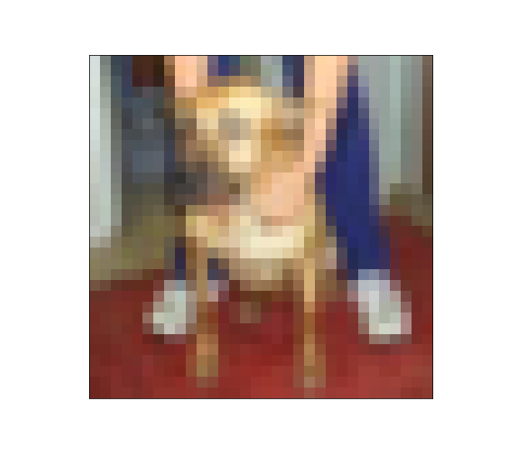
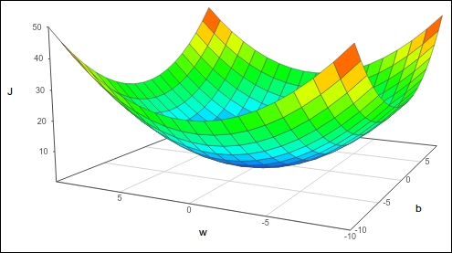
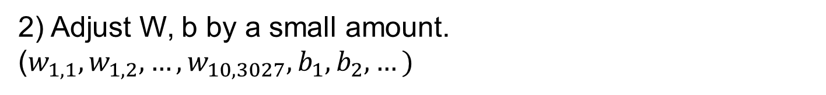

Linear classifier
1) Evaluate the linear classifier.
Scores
Image $x^{(i)}$
cat:
3.8
3.6
3.8
3.2
dog:
-1.1
2.6
3.9
5.1
car:
1.3
2.3
2.0
-1.7
W (1)
W (2)
W (3)
W (4)
loss function: How bad are the predictions?
2) Adjust W, b by a small amount.
($w_{1,1},w_{1,2}, …,w_{10,3027},b_{1},b_{2}, …)$
Minimize loss function with respect to W and b
Notes:
This is kind of hand wavy approach
To write an algorithm to do these things and determine automatically which W will be the best, we need some way to quantify the badness of any particular W

Slide 5

Loss function (max vs. softmax)
Image $x^{(i)}$
Which one
is the max?
Correct
answer
Scores
cat:
3.2
0
0
dog:
5.1
1
=
1
Correct (0)
car:
-1.7
0
0
cat:
3.6
1
0
dog:
2.6
0
≠
1
Wrong (1)
car:
2.3
0
0
cat:
3.8
1
0
dog:
-1.1
0
≠
1
Wrong (1)
car:
1.3
0
0

Slide 6
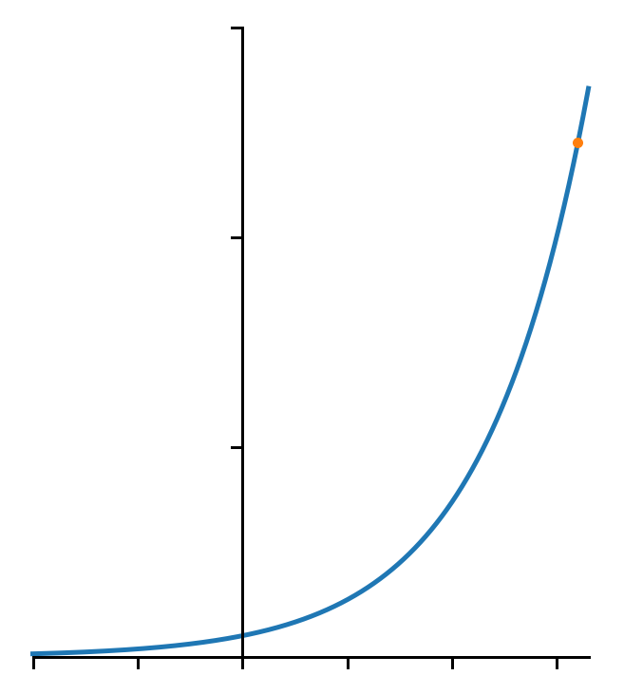



Loss function (max vs. softmax)
Image $x^{(i)}$
Convert
to > 0
Normalize
(sum = 1)
Correct
answer
Scores
cat:
3.2
24.5
0.13
0
exp
normalize
dog:
5.1
164.0
0.87
1
car:
-1.7
0.18
0.00
0
$$\frac{24.5}{24.5+164.0+0.18}$$
$$e^{3.2}=24.5$$
30
20
$$e^{x}$$
10
-2
-1
0
1
2
3
Notes:
So far we have not given much interpretation to the scores spit out by our linear model. We have input X, and weight matrix W and it was somehow spitting out some collection of scores for each category. In calculating the loss function, we are giving some interpretations to the scores that the model is predicting. With the cross-entropy loss, what we want to do is to try to find a way to have some probalistic interpretation of the scores predicted by the model, and we’d like to find a way to take this arbitrary vector of scores and interpret it as a probability distribution over all the categories we are trying to recognize.
The way to do this is with this particular function called softmax that has some functional form here. What we want to do is to take the raw scores predicted by the model, and these raw scores are called unnormalized log-probabilities or logits, you will see this in the program. We first take these raw scores and run them through an exponential functions, so we will take e to the power of an individual score, and apply this element wise from the score vector. So the probability distribution is supposed to be non-negative, and the output of exponential is also non-negative so this is a way to transform the data to be non-negative. These are called unnormalized probabilities. This name of unnormalized probabilities is very suggestive, it tell you that the next thing we want to do is to normalize. So we will take the sum of all the unnormalized probabilities and divide each of the unnormalized probabilies by the sum. After this operation, we now have a vector, each element of which is non-zero and which sums to 1.
Now this vector we can interpret as a probability distribution of all the classes that we are trying to recognize. This combination of taking exponential and dividing by the sum of the exponentials is called the softmax function and this gets used in a lot of different places in machine learning.

Slide 7
Loss function (max vs. softmax)
Image $x^{(i)}$
Convert
to > 0
Normalize
(sum = 1)
Correct
answer
Scores
cat:
3.2
24.5
0.13
0
exp
normalize
dog:
5.1
164.0
0.87
1
car:
-1.7
0.18
0.00
0
cat:
3.6
36.6
0.61
0
exp
normalize
dog:
2.6
13.5
0.22
1
car:
2.3
9.97
0
0.17
cat:
3.8
44.7
0.92
0
exp
normalize
dog:
-1.1
0.33
0.007
1
car:
1.3
3.67
0.08
0
Notes:
So far we have not given much interpretation to the scores spit out by our linear model. We have input X, and weight matrix W and it was somehow spitting out some collection of scores for each category. In calculating the loss function, we are giving some interpretations to the scores that the model is predicting. With the cross-entropy loss, what we want to do is to try to find a way to have some probalistic interpretation of the scores predicted by the model, and we’d like to find a way to take this arbitrary vector of scores and interpret it as a probability distribution over all the categories we are trying to recognize.
The way to do this is with this particular function called softmax that has some functional form here. What we want to do is to take the raw scores predicted by the model, and these raw scores are called unnormalized log-probabilities or logits, you will see this in the program. We first take these raw scores and run them through an exponential functions, so we will take e to the power of an individual score, and apply this element wise from the score vector. So the probability distribution is supposed to be non-negative, and the output of exponential is also non-negative so this is a way to transform the data to be non-negative. These are called unnormalized probabilities. This name of unnormalized probabilities is very suggestive, it tell you that the next thing we want to do is to normalize. So we will take the sum of all the unnormalized probabilities and divide each of the unnormalized probabilies by the sum. After this operation, we now have a vector, each element of which is non-zero and which sums to 1.
Now this vector we can interpret as a probability distribution of all the classes that we are trying to recognize. This combination of taking exponential and dividing by the sum of the exponentials is called the softmax function and this gets used in a lot of different places in machine learning.

Slide 8
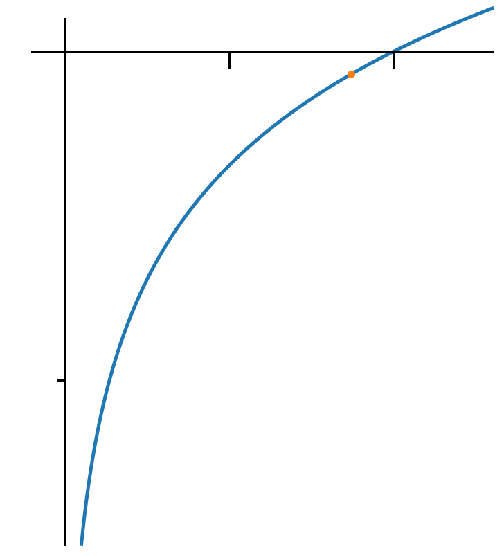

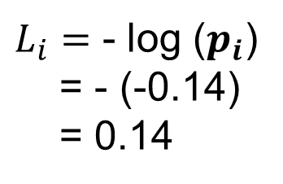


Loss function (max vs. softmax)
Image $x^{(i)}$
Convert
to > 0
Normalize
(sum = 1)
Correct
answer
Scores
cat:
3.2
24.5
0.13
0
exp
normalize
dog:
5.1
164.0
0.87
1
car:
-1.7
0.18
0.00
0
Quantify how far this is
From the answer
0
1
$$p_{i}=0.87$$
$$\log{x}$$
$$\log{p_{i}}=−0.14$$
$L_{i}=$ - log ($p_{i}$)
= - (-0.14)
= 0.14
-2
Notes:
So far we have not given much interpretation to the scores spit out by our linear model. We have input X, and weight matrix W and it was somehow spitting out some collection of scores for each category. In calculating the loss function, we are giving some interpretations to the scores that the model is predicting. With the cross-entropy loss, what we want to do is to try to find a way to have some probalistic interpretation of the scores predicted by the model, and we’d like to find a way to take this arbitrary vector of scores and interpret it as a probability distribution over all the categories we are trying to recognize.
The way to do this is with this particular function called softmax that has some functional form here. What we want to do is to take the raw scores predicted by the model, and these raw scores are called unnormalized log-probabilities or logits, you will see this in the program. We first take these raw scores and run them through an exponential functions, so we will take e to the power of an individual score, and apply this element wise from the score vector. So the probability distribution is supposed to be non-negative, and the output of exponential is also non-negative so this is a way to transform the data to be non-negative. These are called unnormalized probabilities. This name of unnormalized probabilities is very suggestive, it tell you that the next thing we want to do is to normalize. So we will take the sum of all the unnormalized probabilities and divide each of the unnormalized probabilies by the sum. After this operation, we now have a vector, each element of which is non-zero and which sums to 1.
Now this vector we can interpret as a probability distribution of all the classes that we are trying to recognize. This combination of taking exponential and dividing by the sum of the exponentials is called the softmax function and this gets used in a lot of different places in machine learning.

Slide 9
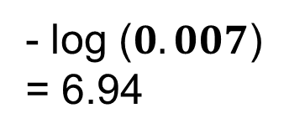
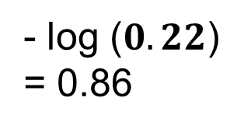
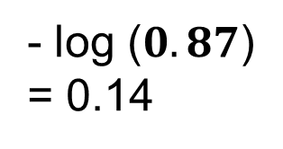
Loss function (max vs. softmax)
Image $x^{(i)}$
Convert
to > 0
Normalize
(sum = 1)
Scores
Target
cat:
3.2
24.5
0.13
0
exp
normalize
dog:
5.1
164.0
0.87
1
car:
-1.7
0.18
0.00
- log ($0.87$)
= 0.14
0
cat:
3.6
36.6
0.61
0
exp
normalize
dog:
2.6
13.5
0.22
1
car:
2.3
9.97
- log ($0.22$)
= 0.86
0
0.17
cat:
3.8
44.7
0.92
0
exp
normalize
dog:
-1.1
0.33
0.007
1
car:
1.3
3.67
- log ($0.007$)
= 6.94
0
0.08
Notes:
So far we have not given much interpretation to the scores spit out by our linear model. We have input X, and weight matrix W and it was somehow spitting out some collection of scores for each category. In calculating the loss function, we are giving some interpretations to the scores that the model is predicting. With the cross-entropy loss, what we want to do is to try to find a way to have some probalistic interpretation of the scores predicted by the model, and we’d like to find a way to take this arbitrary vector of scores and interpret it as a probability distribution over all the categories we are trying to recognize.
The way to do this is with this particular function called softmax that has some functional form here. What we want to do is to take the raw scores predicted by the model, and these raw scores are called unnormalized log-probabilities or logits, you will see this in the program. We first take these raw scores and run them through an exponential functions, so we will take e to the power of an individual score, and apply this element wise from the score vector. So the probability distribution is supposed to be non-negative, and the output of exponential is also non-negative so this is a way to transform the data to be non-negative. These are called unnormalized probabilities. This name of unnormalized probabilities is very suggestive, it tell you that the next thing we want to do is to normalize. So we will take the sum of all the unnormalized probabilities and divide each of the unnormalized probabilies by the sum. After this operation, we now have a vector, each element of which is non-zero and which sums to 1.
Now this vector we can interpret as a probability distribution of all the classes that we are trying to recognize. This combination of taking exponential and dividing by the sum of the exponentials is called the softmax function and this gets used in a lot of different places in machine learning.

Slide 10
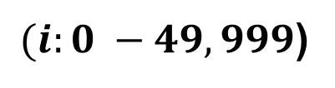
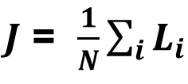
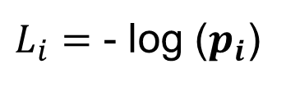

Loss function (max vs. softmax)
Image $x^{(i)}$
Convert
to > 0
Normalize
(sum = 1)
Scores
Target
cat:
3.2
24.5
0.13
0
exp
normalize
dog:
5.1
164.0
0.87
1
car:
-1.7
0.18
0.00
0
Distance
from the target
$J$ = $\frac{1}{N}\sum_{i}{L_{i}}$
$(i:0 −49,999$)
$L_{i}=$ - log ($p_{i}$)
What is the min/max possible loss $L_{i}$?
Min 0, max: Inf
If all scores are similar, what is the loss (3 categories)
- log (1/3) = 1.09
If all scores are similar, what is the loss (10 categories)
- log (1/10) = 2.30
Notes:
So far we have not given much interpretation to the scores spit out by our linear model. We have input X, and weight matrix W and it was somehow spitting out some collection of scores for each category. In calculating the loss function, we are giving some interpretations to the scores that the model is predicting. With the cross-entropy loss, what we want to do is to try to find a way to have some probalistic interpretation of the scores predicted by the model, and we’d like to find a way to take this arbitrary vector of scores and interpret it as a probability distribution over all the categories we are trying to recognize.
The way to do this is with this particular function called softmax that has some functional form here. What we want to do is to take the raw scores predicted by the model, and these raw scores are called unnormalized log-probabilities or logits, you will see this in the program. We first take these raw scores and run them through an exponential functions, so we will take e to the power of an individual score, and apply this element wise from the score vector. So the probability distribution is supposed to be non-negative, and the output of exponential is also non-negative so this is a way to transform the data to be non-negative. These are called unnormalized probabilities. This name of unnormalized probabilities is very suggestive, it tell you that the next thing we want to do is to normalize. So we will take the sum of all the unnormalized probabilities and divide each of the unnormalized probabilies by the sum. After this operation, we now have a vector, each element of which is non-zero and which sums to 1.
Now this vector we can interpret as a probability distribution of all the classes that we are trying to recognize. This combination of taking exponential and dividing by the sum of the exponentials is called the softmax function and this gets used in a lot of different places in machine learning.

Slide 11
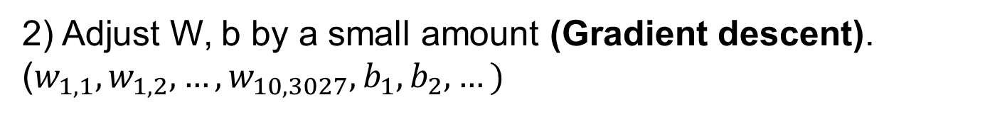
Linear classifier
$$f(x,W, b)= Wx+b$$
Using 50k training dataset, optimize W, b iteratively.
The training starts with a random values in W, b.
1) Evaluate the linear classifier (loss function).
2) Adjust W, b by a small amount (Gradient descent).
($w_{1,1},w_{1,2}, …,w_{10,3027},b_{1},b_{2}, …)$
Notes:
This slide will show the basic idea of linear classifier. Here we use CIFAR 10 that we talked about as an example. It has 50K training data set that are categorized in 10 classes. Each of the image is 32 x 32 x 3, 32 pixels in horizontal axis, 32 vertical axis, and 3 color of red, green and blue. that in total corresponds to 3072 pixels. There are 10 categories, so the program needs to create
Ok, so the main job of the linear classifier is to create a template image that has the same size as the input image, for each categories using these 50K training images. The template will have the same size as these images, so 3072 pixels for each template.
We will go through how the program creates these templates later, but for now let’s assume that the program has created templates, and let me explain how the program use these templates.

